Slide 1
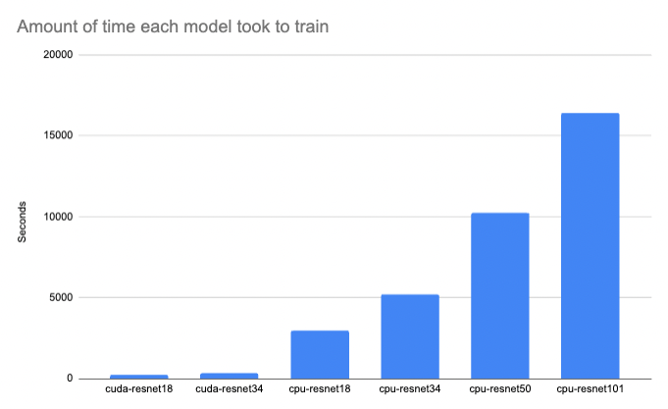
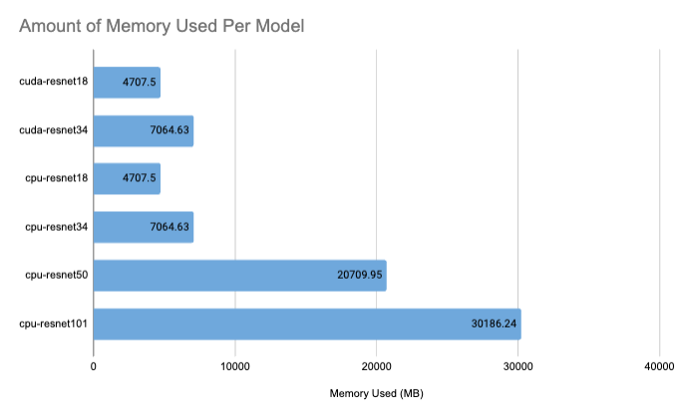
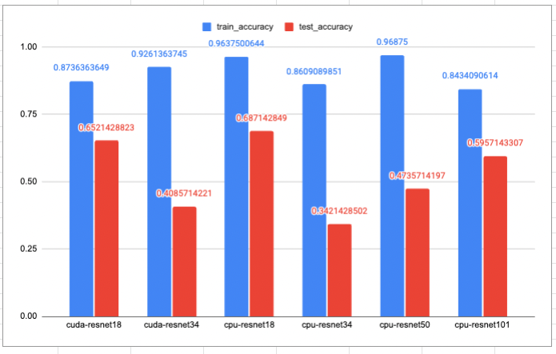
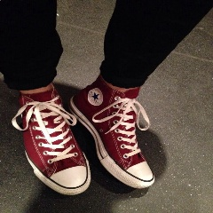
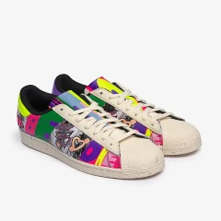
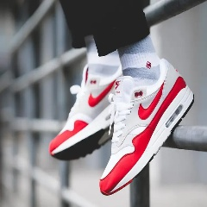


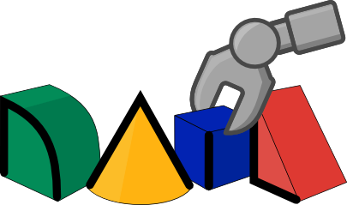
Problem Spaces to test:
Classification problem – Identify brand of shoes
Regression problem – Vehicle steering angle (May Not Do)
QR code to more info ....
Metrics to Evaluate:
- Accuracy of classification
- Time to complete experiment
- Amount of memory used
Scope of the Experiments
1. Look at different model sizes and compare resource requirements and synthetic performance outputs
2. Compare different data processing techniques and their effects on performance of the models
3. Compare different hardware and framework tools and tunable parameters to improve efficiency of training
Other notable elements to this work
- All experiments were run in Python 3.10.5 using Anaconda and PyTorch, other libraries may behave differently
- Used a PC with 64GB of RAM, 6 cores, 12 threads and an Nvidia RTX 3060 with 12 GB of RAM
Computer Vision does not have to rely on the biggest and most expensive models to produce viable results.
Access to vision systems, especially for AI on the Edge is not always costly to get good results
Methodology
Experiment 2
This experiment focuses on pre-processing of the dataset (image inputs) and the effect of reducing the incoming data size to the overall synthetic performance of the baseline (ResNET18) model.
Experiment 3
In this experiment I look at the impact of model size on performance.
For the first type of model, classifying the type of shoe seen in an image is used.
4 models were used within the ResNet family of computer vision convolutional neural network models. (TorchVision pre-implemented models were used).
Interestingly the smallest model (which is the fastest to train) performed the best in the synthetic test dataset, and was trainable with far less resources available
The model performance results by leveraging hardware and library tools which improve performance and reduce resource requirements
Experiment 1
About me
References
I am a senior software engineer at a Fintech called DocFox and a master’s candidate at the University of the Witwatersrand focusing on computer vision, explainable AI and self-driving cars
Jason Chalom (711985)¹
Supervisor: Dr Richard Klein¹
¹University of the Witwatersrand, South Africa
The model performance results by leveraging hardware and library tools which improve performance and reduce resource requirements
Jason Chalom¹
Supervisor: Dr Richard Klein¹
¹University of the Witwatersrand, South Africa
RAIL Lab

